Slide 1
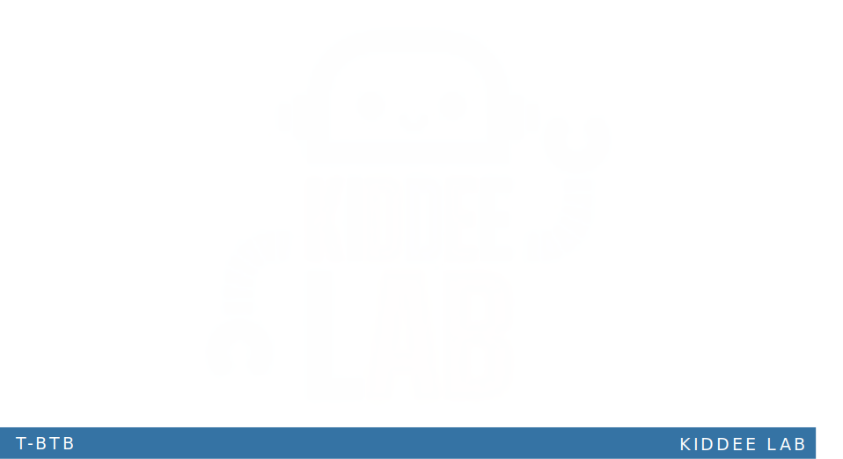

K-mean Clustering

Slide 2
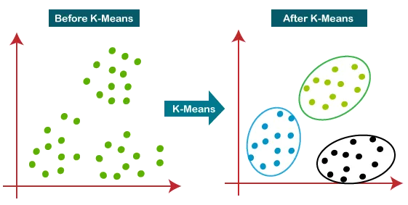
What is Clustering

Slide 3

How does the K-means Algorithm work?
The K-means algorithm works in the following steps:
Initialize K centroids randomly.
Assign each data point to its closest centroid based on the distance metric.
Update the centroids by calculating the mean of all the data points assigned to the centroid.
Reassign each data point to its closest centroid.
Repeat steps 3 and 4 until convergence.
Note : The distance between two points can be calculated using various distance metrics such as Euclidean distance, Manhattan distance, and Minkowski distance.
Euclidean distance : $(\left(x,y\right),\left(a,b\right))=\sqrt{{(x−a)}^{2}+{(y−b)}^{2}}$
Manhattan Distance : $\left(x_{1},y_{1}\right) and \left(x_{2},y_{2}\right)=|\left(x_{1}−x_{1}\right)$ | + | $\left(y_{1}−y_{2}\right)$|

Slide 4
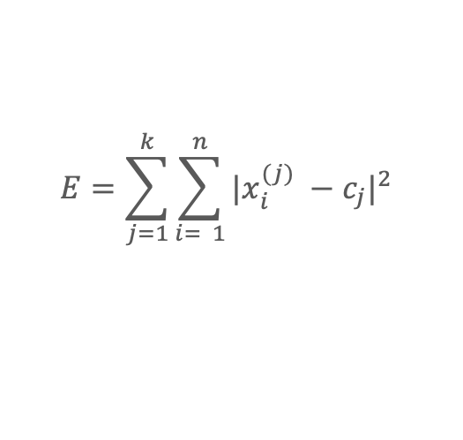
Squared Error Function
Number of Cases
Number of Clusters
Case i
Centroid for cluster j
$$E=\sum_{j=1}^{k}{\sum_{i= 1}^{n}{{|x_{i}^{(j)} −c_{j}|}^{2}}}$$
Objective functions
Distance Function

Slide 5
How does the K-means Algorithm work?
The K-means algorithm works in the following steps:
Initialize K centroids randomly.
Assign each data point to its closest centroid based on the distance metric.
Update the centroids by calculating the mean of all the data points assigned to the centroid.
Reassign each data point to its closest centroid.
Repeat steps 3 and 4 until convergence.
Note : The distance between two points can be calculated using various distance metrics such as Euclidean distance, Manhattan distance, and Minkowski distance.

Slide 6
Applications of the K-means Algorithm
Image Segmentation:
K-means algorithm segments images by grouping similar pixels together based on color, texture, or other features.
Helps divide images into distinct regions for analysis or processing.
Data Compression:
Utilizes K-means to reduce data dimensionality by clustering similar data points together.
Represents data using centroids of clusters, leading to a lower-dimensional representation.
Market Segmentation:
Applies K-means to group customers based on preferences and behavior.
Clusters customers according to purchase history, demographics, or other features to enable targeted marketing strategies.

